Slide 1
Souderton Mennonite Homes Expansion and Renovations Edward D. Brubaker, President/CEO May 2022

Slide 2
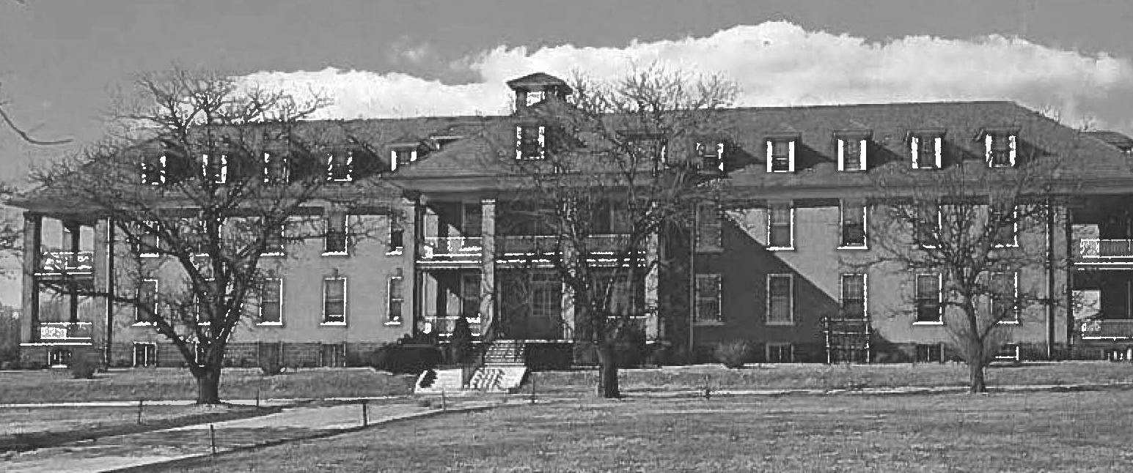
Background
Souderton Mennonite Homes was established in 1917 as Eastern Mennonite Home of Franconia District.
71 Health Care beds, one private room.

Slide 3
Planning
Dreaming of creating more private rooms for many years.
Challenge: No new income but new costs.
Do it when financially feasible.
Pandemic slowed the planning.
We are now ready to begin: Fall 2022; duration, around two years.

Slide 4
Partner – RLPS Architects
Lancaster-based, nationally prominent firm specializing in senior living design.
Designed interior improvements at Dock Woods in 2016.
Engaged for multi-campus master planning exercise from 2018.

Slide 5
Partner – Benchmark Construction
Lancaster-based construction firm with specialization in senior living.
Constructed interior improvements at Dock Woods in 2017 – 2018.
Selected from four proposing firms in early 2020 to provide pre-construction services. Role as advisory partner in constructability and pricing through design.
Currently providing Guaranteed Maximum Pricing (GMP) proposals for construction at both Dock Woods and SMH.

Slide 6
Partner - Ziegler
National senior living investment banking firm, located in Chicago.
Largest senior living investment banking firm by number of deals and volume.
Chad Himel will lead banking process for Living Branches.
Primary activities:
Lead rating process.
Organize legal team.
Obtain proposal from banks.
Suggest most cost-effective finance plan that accounts for risk tolerance, most likely a mix of bank and bond financing.
Market and sell tax-exempt or taxable bonds
and deliver the money.

Slide 7
Site Plan
18 new Health Care Memory Care beds.
26 new Personal Care Memory Care beds.
New front entry and renovation to Wildflower interior, including relocated offices and corridor refresh.
Current offices renovated into 6 shared private rooms in Park View.

Slide 8
Existing
Health Care renovations:
43 private beds.
22 semi-private beds
6 beds in shared private rooms.
Total of 71 beds. Current census maintained.

Slide 9
New Floor Plan

Slide 10
New Floor Plan

Slide 11
Phasing Plan

Slide 12
Phasing Plan

Slide 13
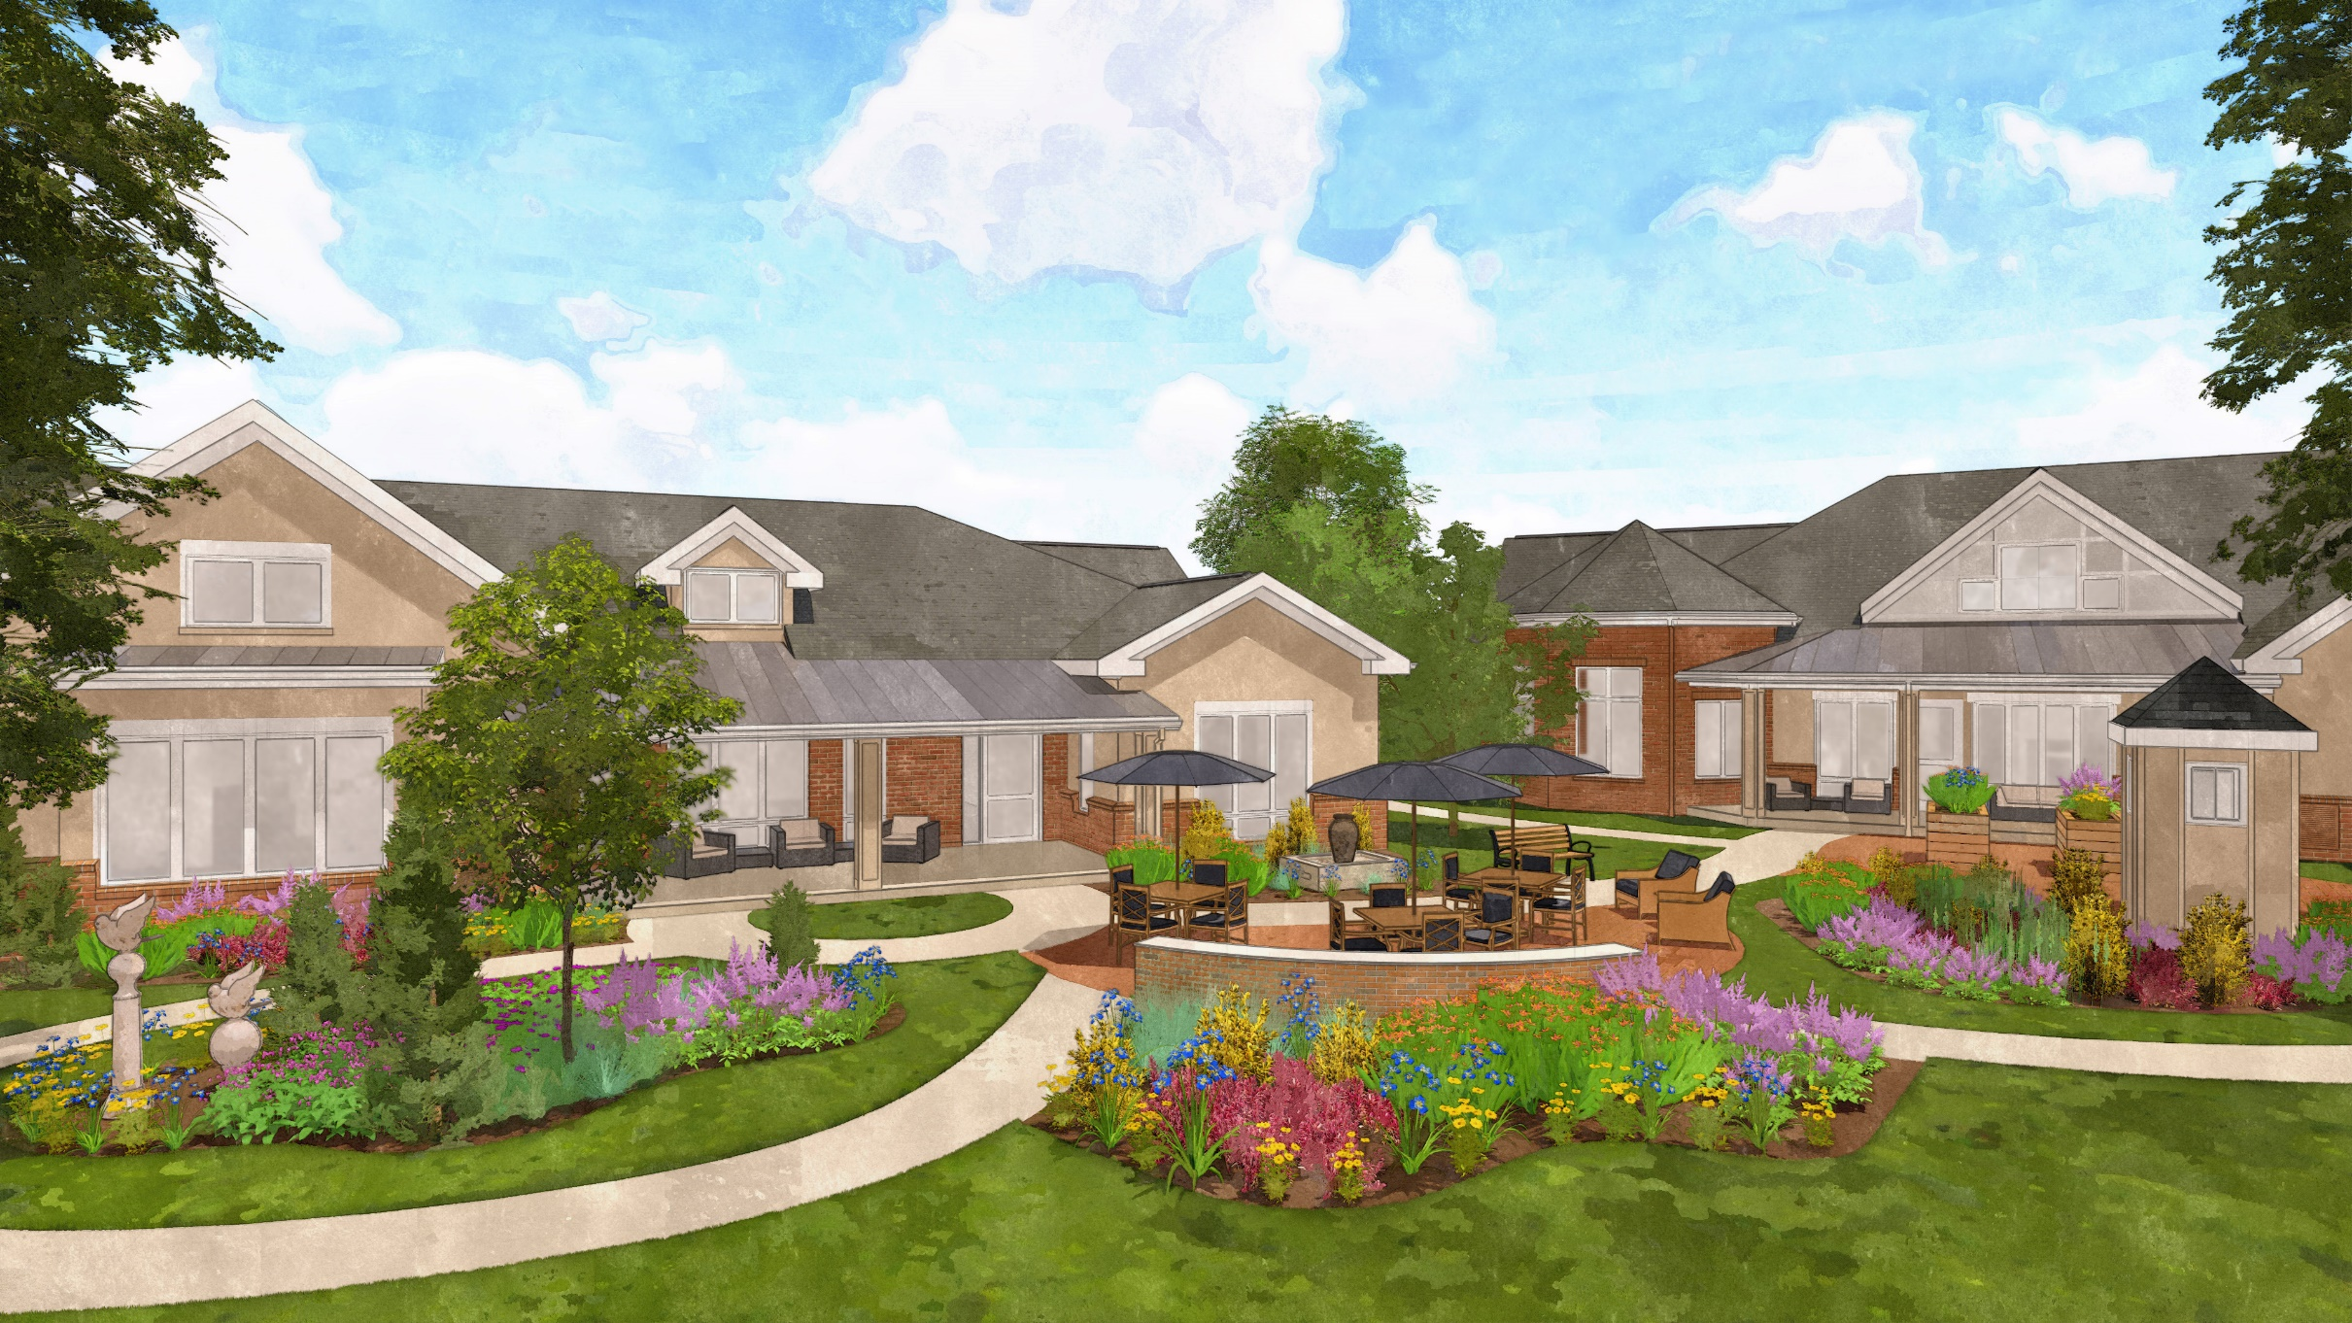

Slide 14
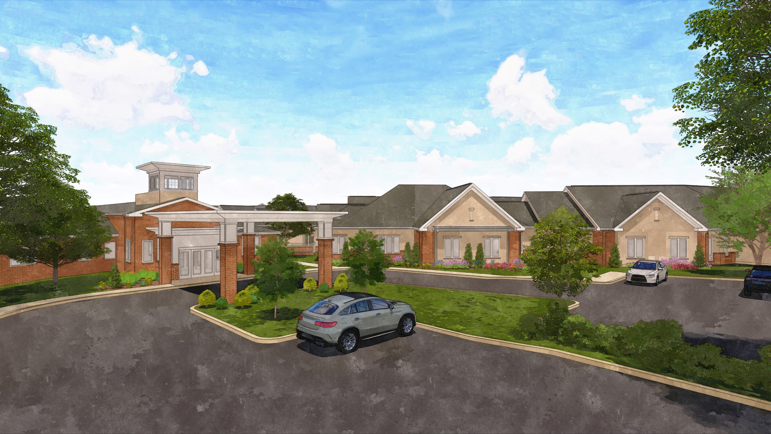

Slide 15
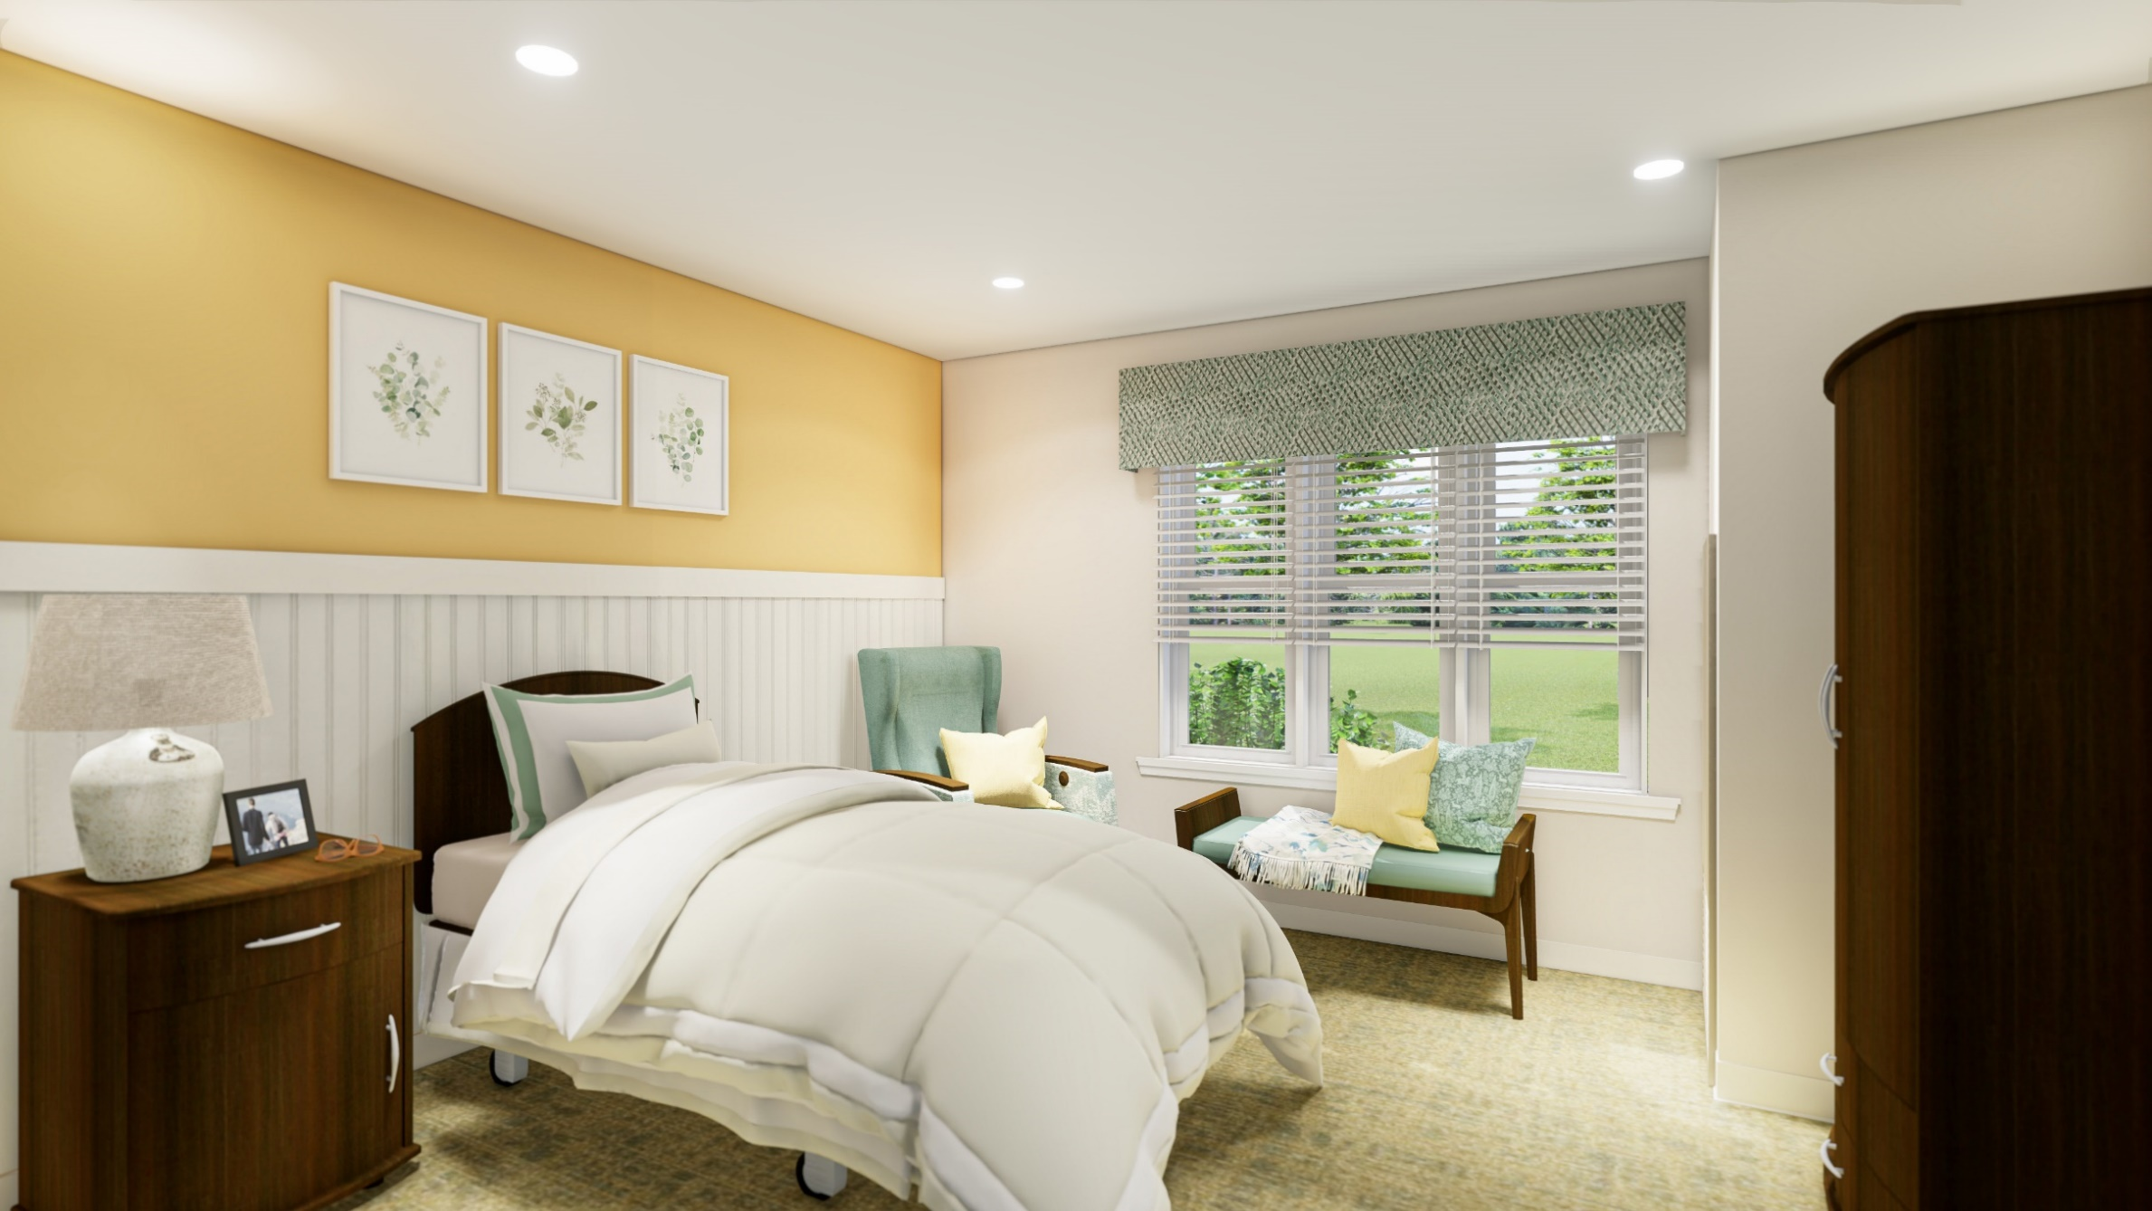

Slide 16
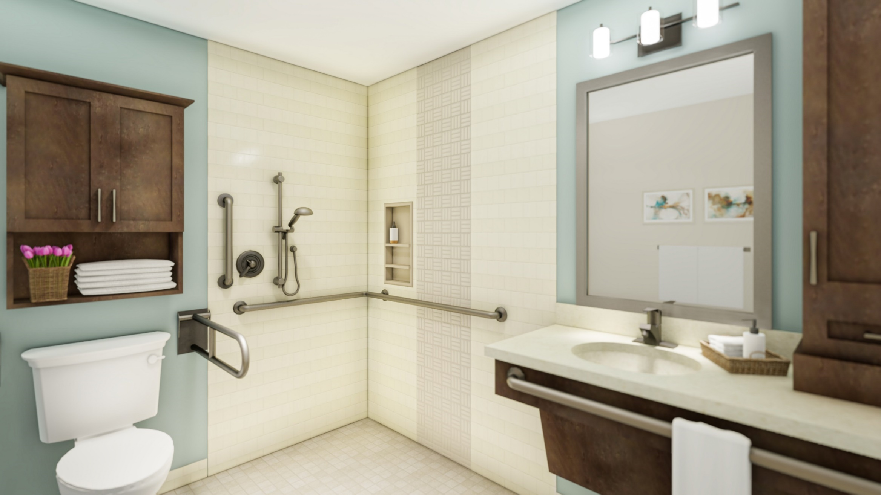

Slide 17
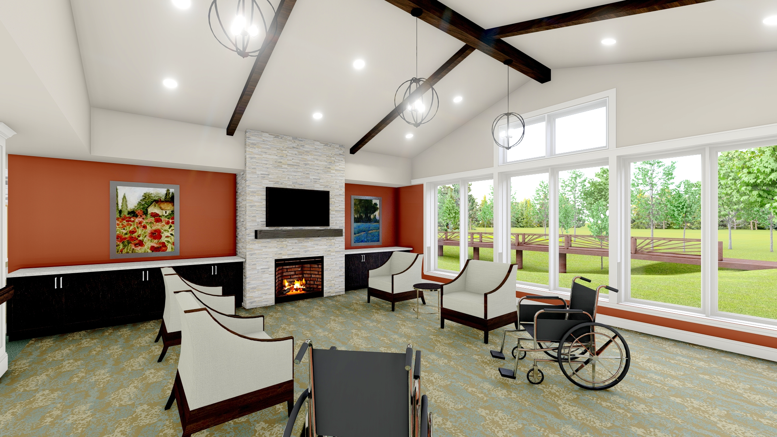

Slide 18
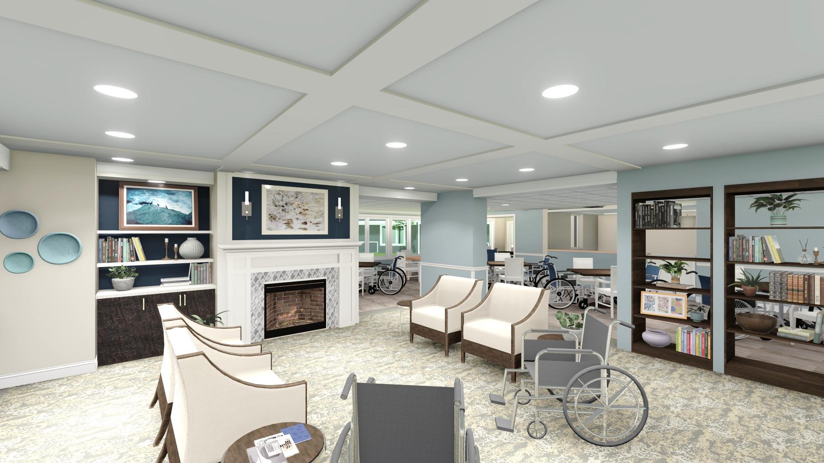

Slide 19
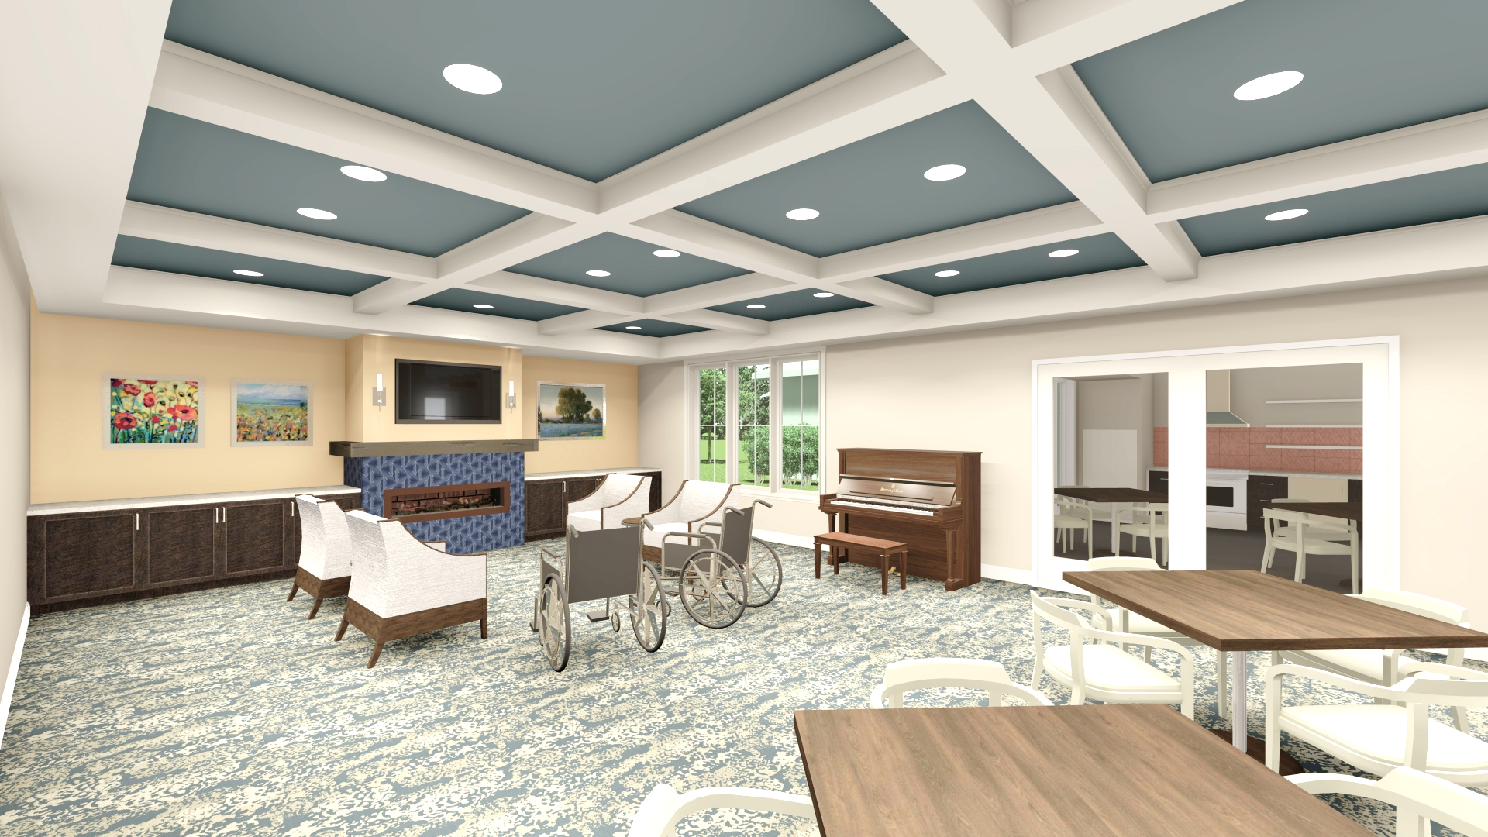

Slide 20
Fundraising
Goal of $3.5 million for capital and creative arts therapy.
Very good support in the silent phase.
Roll out in the coming months to staff, residents, and vendors.

